Slide 1
Update on the plans for the UNGEGN World GN Web Map Application
Issues/Challenges
Adobe Flash Player is no longer supported therefore interactive maps cannot be displayed.
World map has changed, national borders are in dispute, need to access service that maintains current world map.
Updates and maintenance of the database is cumbersome

Slide 2
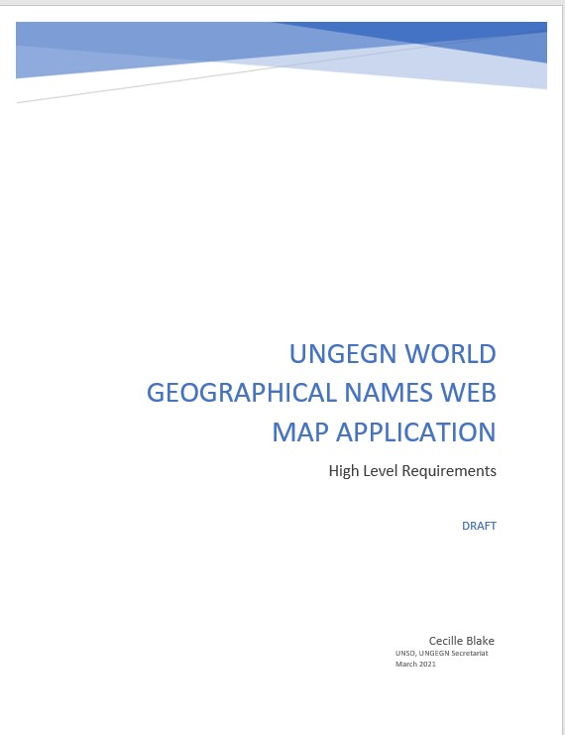
Update on the plans for the UNGEGN World GN Web Map Application
High level requirements prepared
Update existing application given time and resource availability
Team UNSD and Trigyn, India
  Requirements refined
  Map base - incorporation of UN Clear Map and Imagery
  Development of administration panel – for updates and management of the database
  Looking at adding temporal dimension to see and access names changes over time.
  Number of fixes still being made – audio files etc.

Slide 3
Next Steps- some thoughts
Existing map visualization challenges to be solved – internal UN action
Deployment and testing of revamped web application
  Support from the UNGEGN expanded Bureau
Finalizing improvements to the application for 2nd Session
Moving from relational database to graph database structure
Deciding on maintenance and management arrangements
Application of linked data
Increasing cities beyond those with population over 100,000

